Slide 1


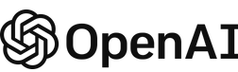

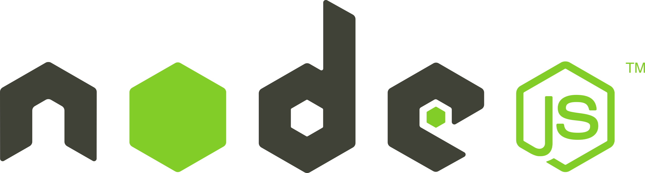





Entra ID
Azure Key Vault
UI App (React.js)
AAD SSO Authentication
Secrets, API Keys
Chat Completions API
/api
Messages API
static app serving
Azure Container App
API Request Logs (Technical Metadata Only)
docker Image
Kusto Querying of statistics (per user)
Azure Container Registry
CI/CD Deploy (Actions Workflow)
https://github.com/DmitriyAlergant-T1A/BetterChatGPT-t1a

